Slide 1
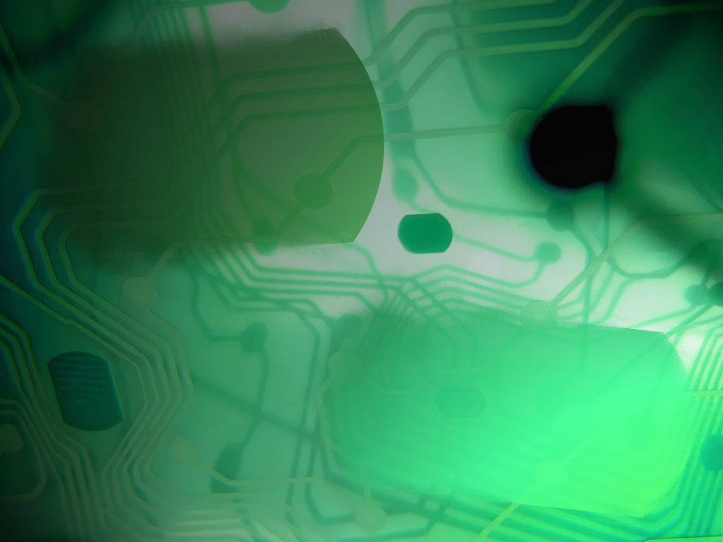
Computer Systems Fundamentals
H175 34
Lecture 5
Basic Hardware

Slide 2
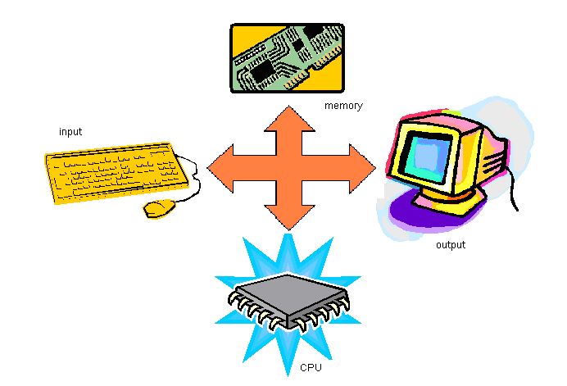
A very basic diagram of a computer system consists of input, output, processing and storage facilities.
In reality, each of these facilities are added to a basic circuit board called a motherboard.

Slide 3
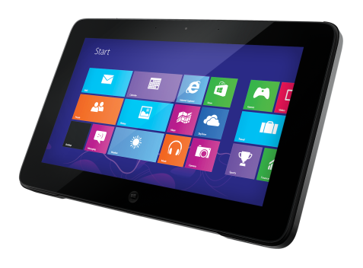

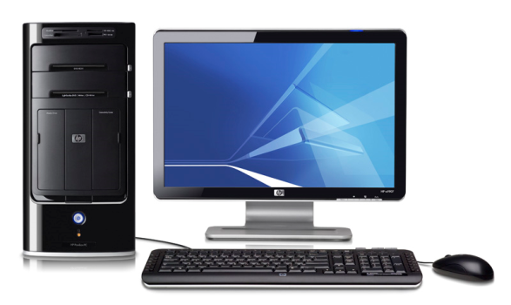
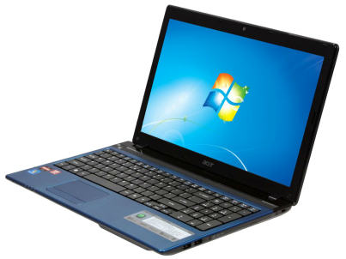
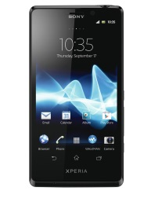
Hardware Elements
Nowadays there are many different types of computer available. They all have similar hardware components, although there can be significant variations in size, capacity, performance etc. In this section we will look at a variety of computer types including desktop, laptop, netbook, ultrabook, tablet and other devices, such as smartphones and e-book readers.

Slide 4
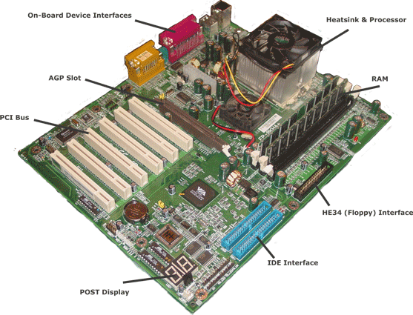
Motherboard

Slide 5
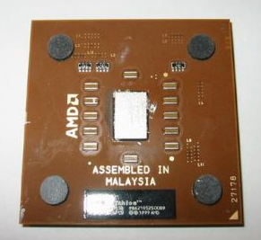
To begin with we will look at the Central Processing Unit, or “Processor”.
The processor is the “heart” of the system, and controls everything else that happens.

Slide 6



The CPU consists of a number of registers.
A register is an area for storing information in a binary format. They are typically made of tiny capacitors (a component capable of holding an electrical charge).
Capacitors can be either charged (1) or discharged (0) allowing the storage of binary values.
Various types of capacitor, used for different purposes. An old name for a capacitor is a condenser.

Slide 7
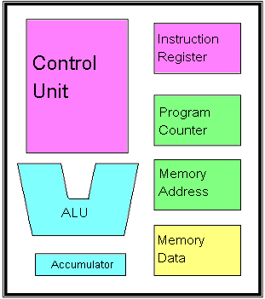
This is a “classic” diagram of a CPU, showing various subcomponents. Each component has it’s own function.
This diagram is not based on any particular model, but they will all have these seven basic components.

Slide 8
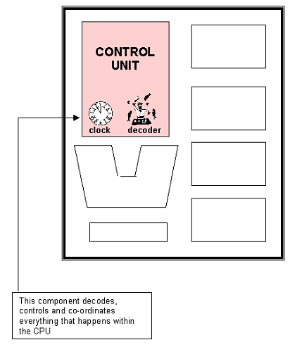
The Control Unit.
An average, modern Control Unit uses about 55 million transistors and capacitors.
It will also contain a Decoder unit and the System Clock.

Slide 9
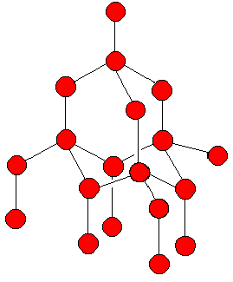
The clock is a tiny crystal of pure silicon, with an electrical current passed across it. This makes it oscillate at very high speeds - in a 1 GHz processor it will vibrate 1,000,000,000 times per second.
The decoder consists of transistors and capacitors. When it receives a program instruction, it interprets the binary code and executes the instruction.

Slide 10
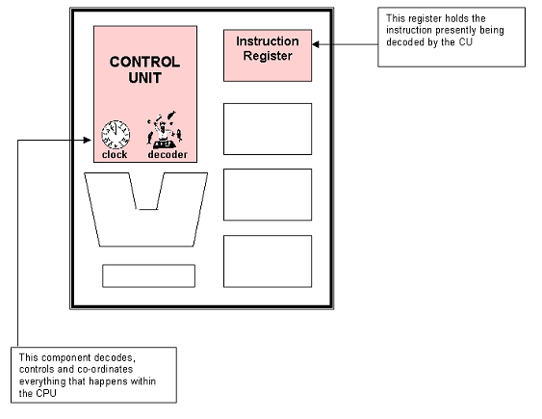
The CU needs a “workspace” where it can decode any instructions it receives.
This is called the Instruction Register.

Slide 11
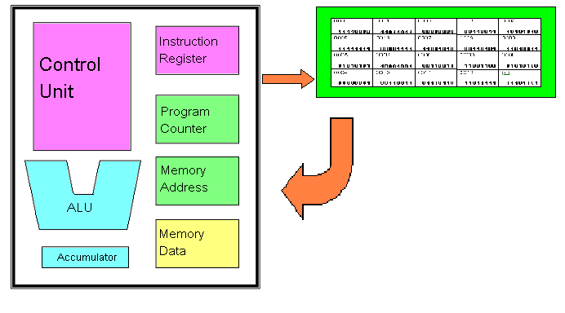
Whenever a program is about to be run, the binary code is first loaded from the hard drive into the RAM (Random Access Memory).
The CU then “imports” it’s instructions from the RAM, one line at a time.

Slide 12
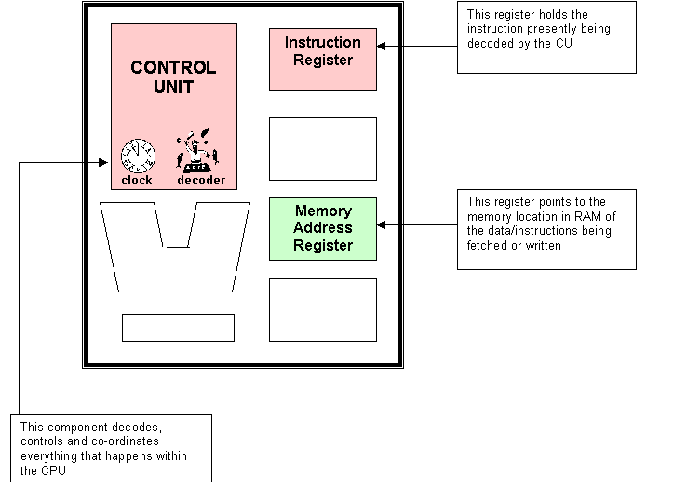
But the CPU needs to know from which address in the RAM - the Memory Address Register points to the right one.

Slide 13
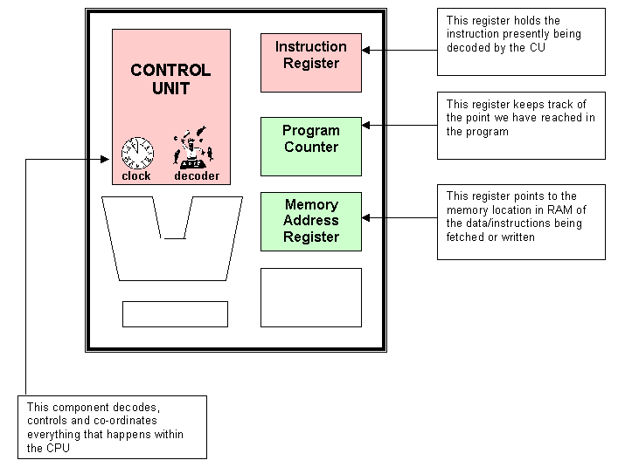
But how does the MAR know where to point?
Usually, the Program Counter tells it.
The Program Counter also keeps track of what point in the program we have reached.

Slide 14
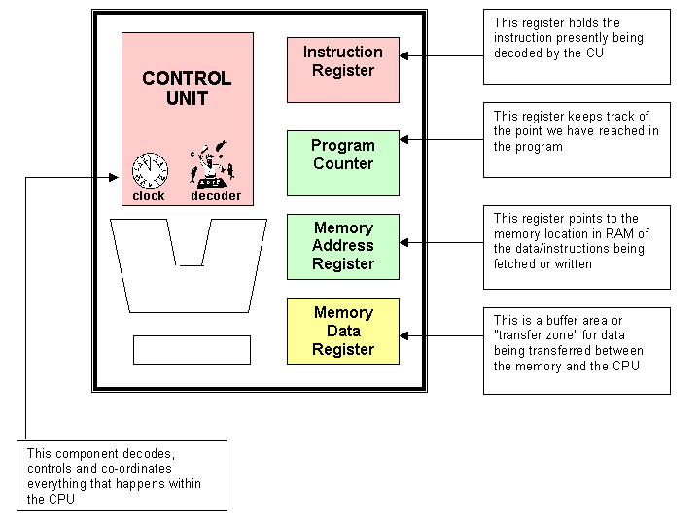
The data and instructions may only enter or leave the CPU by one “portal” or buffer.
This is the Memory Data (Memory Buffer) Register.

Slide 15
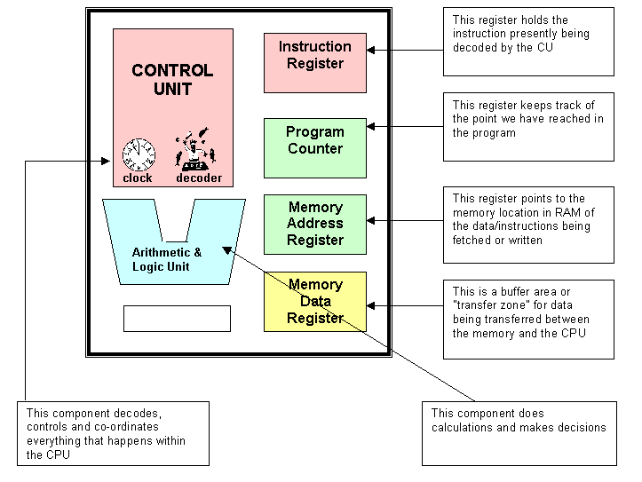
When performing calculations or Boolean logic, data is sent to the Arithmetic and Logic Unit.
The ALU also consists of capacitors and transistors. It is usually depicted as a “V” shape in diagrams.

Slide 16
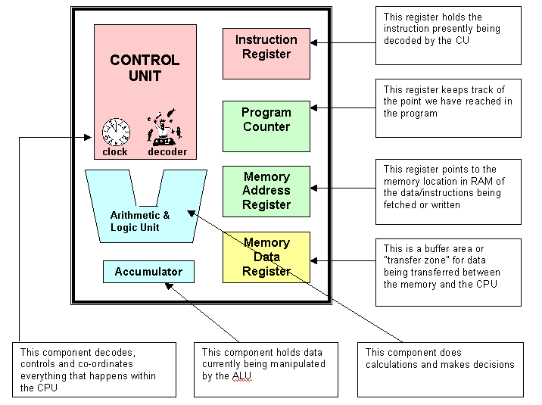
Like the CU, the ALU needs a “workspace” to manipulate values.
This is called the Accumulator.

Slide 17
The seven components shown are essential to the CPU. Different models will have many, many more registers in addition to those shown here.

Slide 18
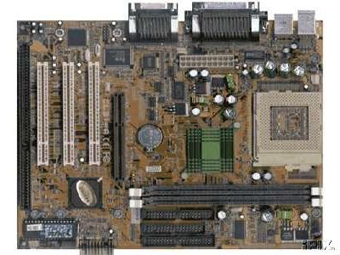
The RAM chips sit apart from the CPU on the motherboard. For the data values to transfer from one place to the other, there must be a physical connection between the two.
We call this connection a BUS. There are three main types of bus in any computer system.
© C Nyssen 2001

Slide 19
The CPU accesses each RAM cell in turn, retrieves the fragment of code and processes (runs) it.
This arrangement is called the Fetch-Decode – Execute cycle.

Slide 20
Types of Bus
Data Bus
Address Bus
Control Bus

Slide 21
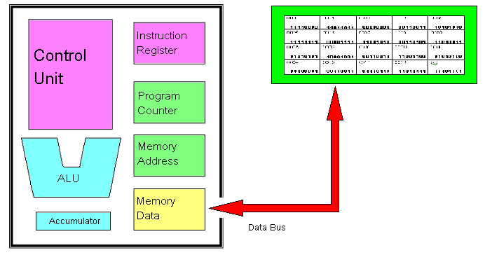
The Data Bus
The RAM is connected to the CPU by copper circuit wires, which can carry electrical signals. Data values are passed along this circuit, the data bus.

Slide 22
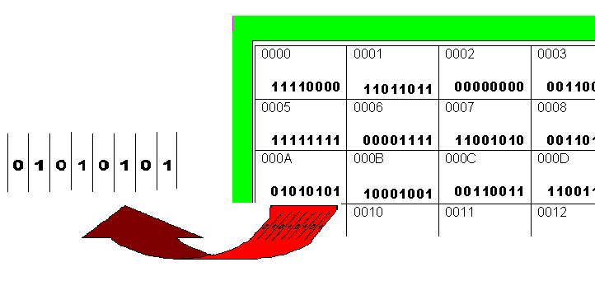
The data bus consists of a flat ribbon of several “wires”, usually in multiples of eight. This enables it to carry whole bytes of information at once.

Slide 23
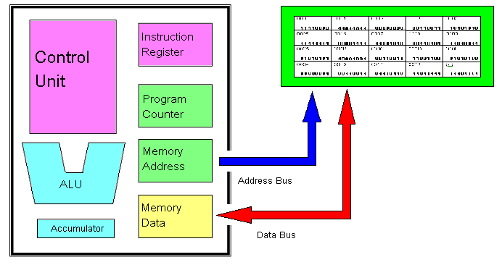
The Address Bus
We already saw that the Memory Address Register points to the correct location in RAM. This particular register is connected to the RAM by the address bus.
The address bus carries binary signals which are then interpreted as address numbers, preparing the correct cell to send or receive data.

Slide 24
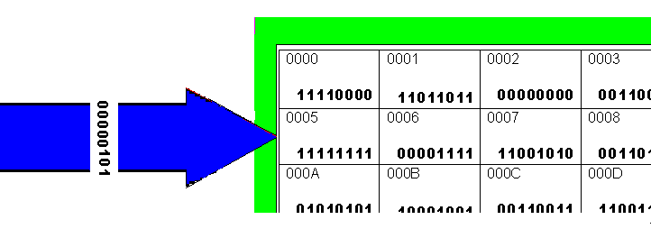
The Address Bus
The address bus can be any number of lines wide. The number of RAM cells it can directly reference, or point to, will be
2^{width of address bus}.

Slide 25
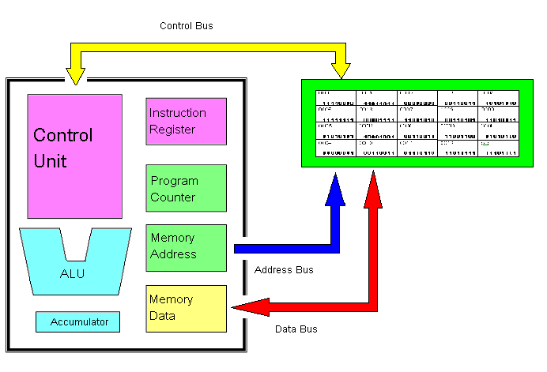
The Control Bus
The third main type of bus connects the Control Unit to all other components. It carries timing and control signals so it is called the control bus.

Slide 26
The data bus is bi-directional – data can flow in both directions between the MDR and the RAM.
The address bus is uni-directional – it only ever points from the MAR to the RAM.
The control bus is bi-directional as the CU sends out control signals and receives acknowledgements.

Slide 27
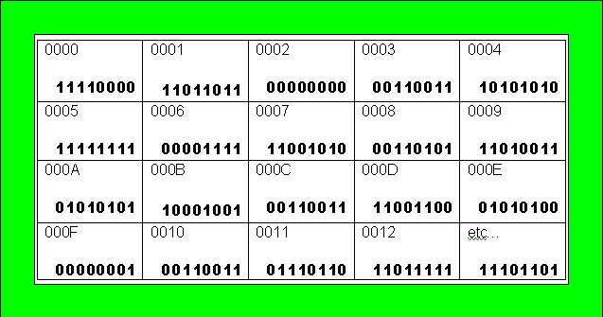
Whenever a program is running, it must first be loaded into RAM. RAM is divided up into cells, each with a unique number.
Each cell contains part of the program code, stored in a binary format.

Slide 28
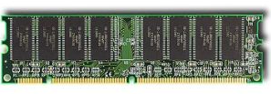
The RAM capacitors can only hold their values for a very small period of time before they discharge.
To retain the values, the capacitors must be constantly refreshed with electrical current.
We therefore refer to RAM as dynamic memory.

Slide 29
RAM is cheap to produce and has a very fast access time. The speed is usually measured in megahertz (MHz). Speed markings on the memory chips may specify a speed in nanoseconds, but in this case it represents the number of nanoseconds between clock cycles.
RAM is volatile – it loses all the stored information if the power is cut off.

Slide 30
You will sometimes see DRAM marketed as –
Synchronous RAM (SDRAM) – this is RAM synchronised to the system buses, waiting for a clock signal before responding – it can run at 100MHz or more. This is the “standard” RAM in most systems.
DRAM (Rambus) – this was a type of RAM specially developed for the Pentium 4. It was also very fast but was so expensive to produce it never really caught on.
Double Datarate RAM (DDRAM) – modern motherboards and processors use this RAM, which effectively doubles transfer rates by using both phases of the clock cycle.

Slide 31
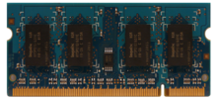
Other RAM types
DDR2/DDR3 have now replaced the original DDR specification. These can transfer data at 4x the normal rate per clock cycle and use less power. They use 240 pins instead of the original 168.

Slide 32
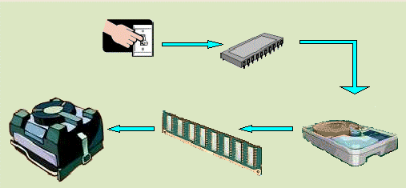
Read Only Memory (ROM)
The role of the ROM chip is to start the computer, perform the Power On Self Test (POST), load basic input and output services, then load the operating system.
For this reason it is sometimes called the Basic Input Output System (BIOS) chip.

Slide 33
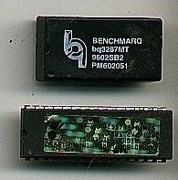

Unlike RAM, the ROM chip is non-volatile; it retains all it’s programming even when the power is switched off. It is based on fuses –some fuses are blown, and some left intact, to form the 1 and 0 values.

Slide 34
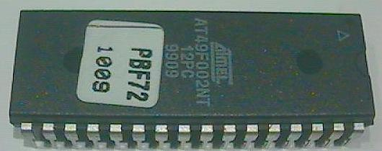
ROM chips have their programs burnt onto them at the point of manufacture. They cannot be subsequently reprogrammed.
They are comparatively expensive to produce and their access times are very slow compared to RAM.

Slide 35
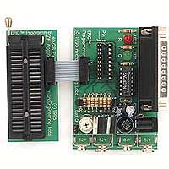
Another type of ROM, often found mounted on peripherals, is Programmable Read Only Memory (PROM).
Unlike a ROM, however, a PROM is manufactured blank. It has its program burned onto it at a later point using a PROM burner.

Slide 36



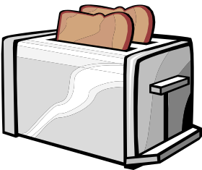
The PROM can only be programmed once – it cannot then be wiped clean and re-used.
Like a ROM, it’s access time is slow.
The setup costs to write the program for a PROM are high, but once the algorithm has been designed, the costs to produce burned PROMS are extremely cheap. They are burned in huge lots and used for many different types of firmware and embedded systems.

Slide 37
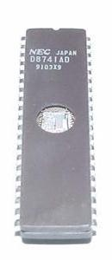
There are also types of PROM available which can be reprogrammed under certain conditions.
These are Eraseable Programmable Read Only Memory (EPROM) and Electrically Erasable Read Only Memory (EEPROM).

Slide 38
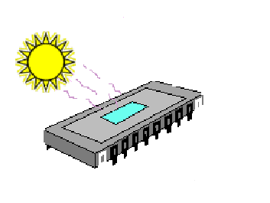
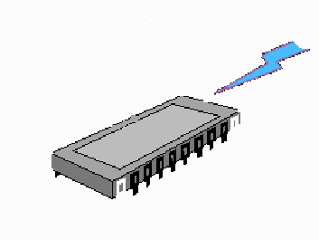
EPROMS are wiped by using UV light, then reprogrammed in a PROM burner.
EEPROMS are wiped using electrical current. They can be reprogrammed using special software or a PROM burner.

Slide 39
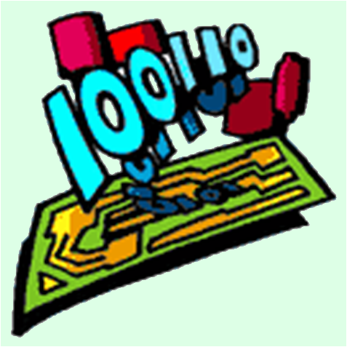
EPROMS and EEPROMS are often used in firmware which will be subject to later upgrading – for example on graphics cards. They are also widely used for Quality Control purposes in motherboard manufacturing.
Like ROM, these are also non-volatile and retain their contents when switched off.
They are expensive to produce
and their access times are slow.

Slide 40
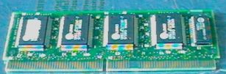
Another form of read/write memory is
Static Random Access Memory (S-RAM).
Do not confuse this with SDRAM!
Modern computers ship with S-RAM installed. Very early computers had little or no S-RAM, and therefore performed very poorly!

Slide 41

Unlike DRAM, S-RAM is composed of bi-polar electric cells. These behave like very small batteries and do not need to be constantly refreshed with current.
S-RAM, however, is still volatile – if the power is cut all the contents are lost.

Slide 42
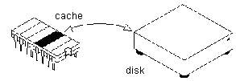
S-RAM is much faster than DRAM (about 10 ns) and more stable, but requires more power and is a lot more expensive to produce.
For this reason it is only ever used as a memory cache.

Slide 43
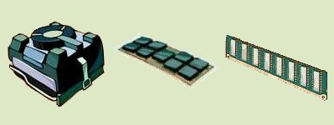
The Cache is memory which sits between the main RAM and the CPU. It works on the Principle of Locality of Reference – data frequently accessed is kept close by, to save time.

Slide 44
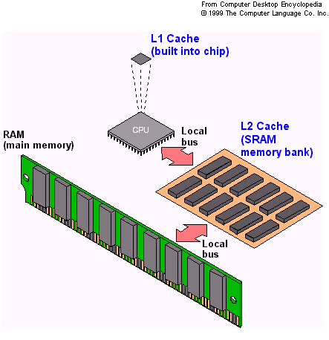
How Cache Works
When the processor needs to read from or write to a location in main memory, it first checks whether a copy of that data is in the cache. If so, the processor immediately reads from or writes to the cache, which is much faster than reading from or writing to main memory.

Slide 45
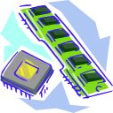
Cache Memory can be located in the Processor itself, on the Motherboard, or both.
The latest Intel I3’s usually ship with 2 or 4 megabytes of on-chip (Level 1) cache.
Asus motherboards typically ship with 256kB or 512kB on-board (Level 2) cache.
The closer the cache is to the processor, the higher the level – and the faster it can be accessed!

Slide 46

The Cache is connected to the CPU by a special data bus called the Front Side Bus. This is an extremely fast data pipeline which often runs at half the speed of the processor – a 1 GHz processor may have a FSB running at 500 MHz or even more.
Front-side bus from CPU to L2 cache

Slide 47
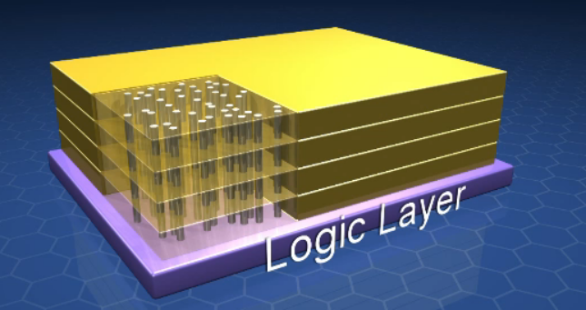
Hybrid Memory
As multi-core CPUs become the norm it is becoming increasingly difficult to move data between main memory and the CPU cores quickly enough to keep the CPU cores fully occupied.
A consortium of memory manufacturers, including Micron, Samsung and Intel, has proposed a solution in the form of the Hybrid Memory Cube, a memory package that offers memory bandwidth up to 1 Tbps, more than 10 times the bandwidth of DDR-3, while using about one-eighth the power per gigabyte.
The Hybrid Memory Cube stacks four or eight DRAM chips on top of memory controller chip. The stack architecture keeps the length of the connections between the memory chips and the controller to a minimum, enabling faster operation and lower power consumption.

Slide 48
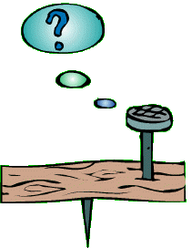
Any Questions?

Slide 49

Summary
The CPU contains a number of registers. These consist of capacitors and transistors.
The CU is the overall controller. It decodes instructions held in the IR. It also contains the system clock.
The PC and MAR are pointer registers. They keep track of where the program has reached and which RAM cell is being currently addressed.
The MDR acts as a point of entry/exit to/from the CPU.
The ALU performs arithmetic and logic operations. It manipulates data in the Accumulator.

Slide 50

Summary
The CPU communicates with the RAM and peripherals by the Busses.
The Data Bus carries data values. It is bi-directional. The number of bits width will always be a multiple of eight.
The Address Bus points to the correct RAM location. It is uni-directional. It can be any width. It can directly reference 2^{width} RAM locations.
The Control Bus carries control and timing signals to all the other components.

Slide 51


Credits
Diamante mouse © geekalerts.com
First motherboard ©Washington State Edu
Second motherboard © Chrissie Nyssen
All other graphics © Focus Multimedia with open licence, unless stated
All other contents © Aberdeen College 2010

